Slide 1
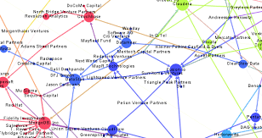
Leveraging the Data Map – A Case Study November 15, 2016

Slide 2
Leveraging the Data Map
Definition of a Data Map
Requirements and Drivers
Components of a Data Map
Data Map Examples
Case Study

Slide 3
Definition of Data Map
An ESI Data Map is a comprehensive and defensible inventory of an organization's IT systems that store information—electronically stored information or ESI—which may be relevant to litigation, regulatory proceedings, government investigations, or audits

Slide 4
US Data Map Requirements
The U.S. Federal Rules of Civil Procedure Rule 26(a)(1)(A) mandates that each party must provide “a copy – or a description by category and location – of all documents (or) electronically stored information”.
The same rule, in paragraph (f), specifies that the parties meet within 90 days of the onset of litigation to plan eDiscovery.
Since a list (or data map) is much easier to produce than actual ‘copies’, data maps are now the norm in U.S. litigation. At the same time, 90 days is usually not enough time to research and create an accurate data map for a large organization; this requirement tends to drive the creation of data maps on a litigation readiness basis for these organizations, rather than as a reaction to a specific law suit.

Slide 5
Canada Data Map Requirements
In Canada we have no such rule, although the Discovery Plan requirement of Rule 29.1.03(2) of the Ontario Rules of Civil Procedure mandates agreement on eDiscovery “before the earlier of (a) 60 days after the close of pleadings...and (b) attempting to obtain evidence” (unless another agreement is reached between the parties). While there is no specific reference to a data map, the extremely tight time frame and associated need to define and issue a legal hold make creation of an organizational data map one of the highest priorities for an organization’s legal team in a case potentially relying on electronic data.

Slide 6
Various Drivers for a Data Map
Legal – Support the identification of relevant information related to a litigation matter, enabling the legal department to respond quickly to discovery requests
IT – Access, Security and Privacy of information
RIM – Identification of records, retention and disposition

Slide 7
Typical Components of an ESI Data Map
A high-level, software independent catalogue of type of ESI that the organization produces, such as reports, documents, emails, schedules, plans, etc.
An identification of all structured, semi-structured and unstructured ESI that contains business records.
A listing of who manages the various types of information. Including a list of the IT and business unit managers most likely to be responsible for the systems and information that store relevant ESI.

Slide 8
Typical Components of an ESI Data Map
Related ESI Policies, such as document retention, backup, and acceptable use policies, as well as the name, title and contact information of the person or people responsible for enforcing these policies.
An evaluation of the accessibility of the various types of information, with the goal of identifying sources of ESI that may be too difficult or costly to access, in order to support claims that data is not readily accessible.

Slide 9
ESI Data Map Gaps
Paper and electronic records stored in department offices, including:
Records unknown to Legal or IT
Third party applications unknown to Legal or IT
Paper records stored in off-site storage facility

Slide 10
Parties Involved in Building a Data Map
Legal Counsel
eDiscovery experts
IT representatives
Information Security representatives
Compliance officer
Records Manager

Slide 11
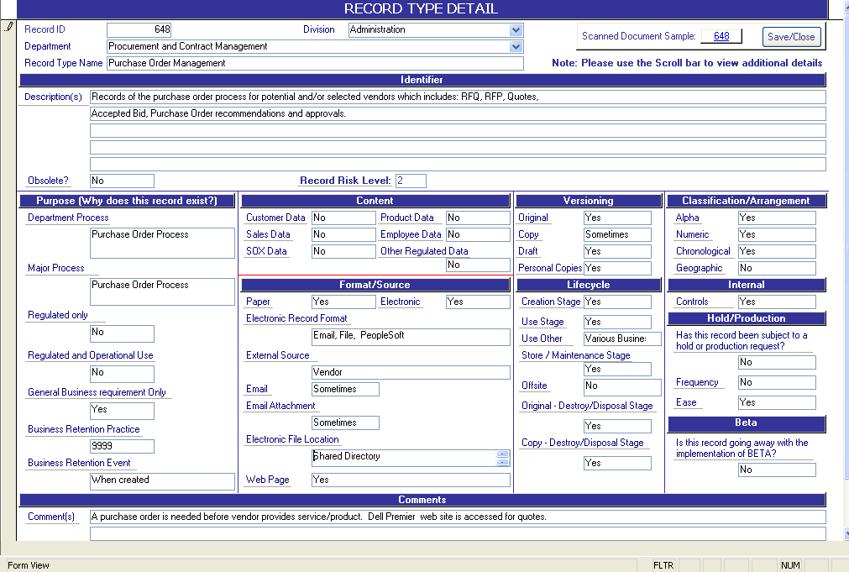
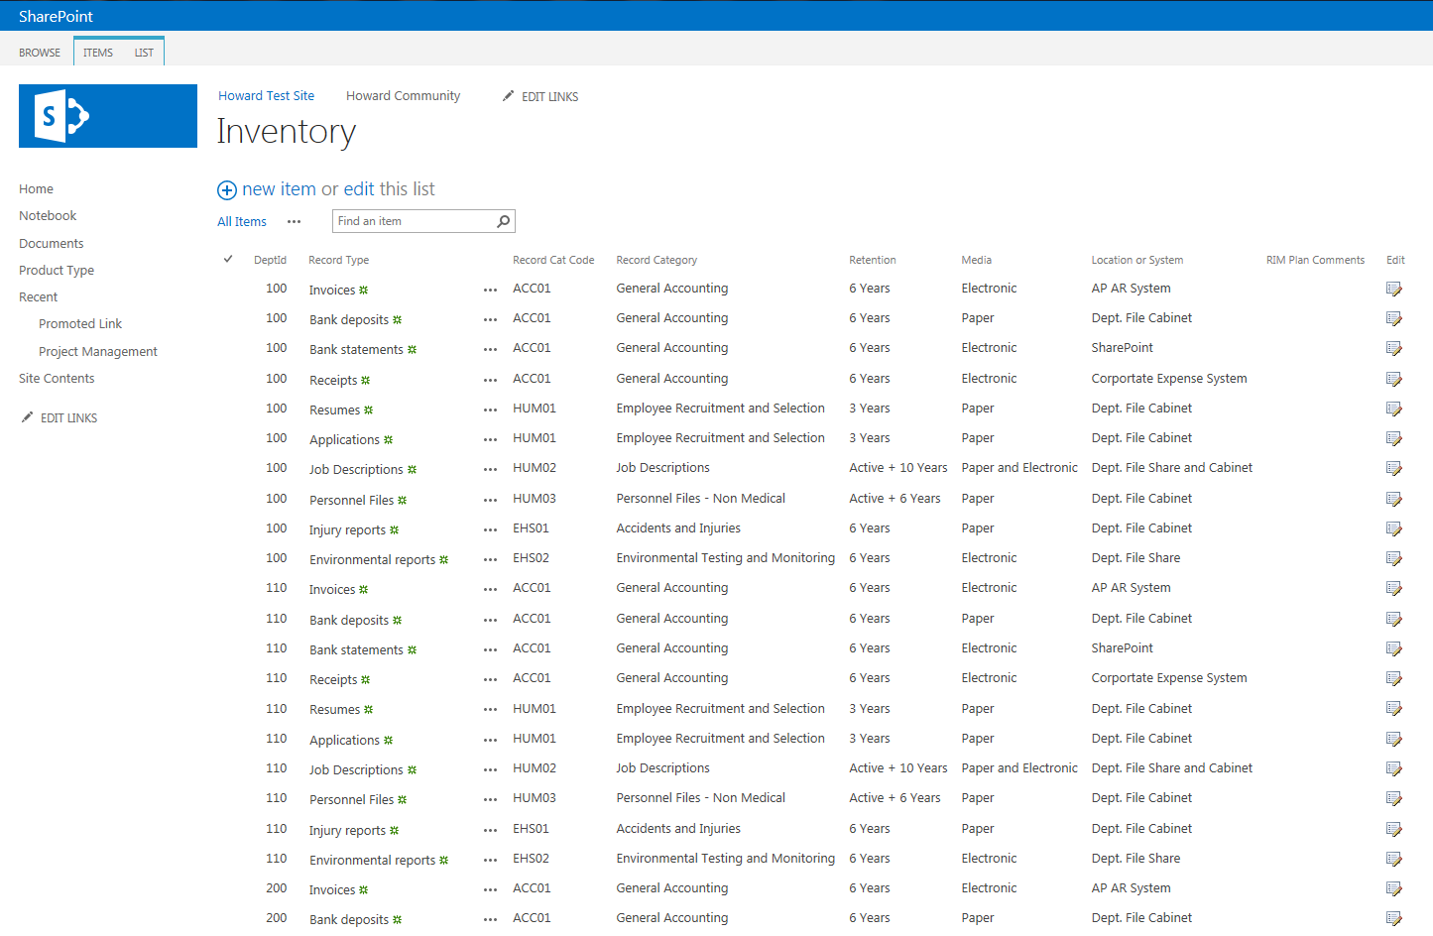
Example Approaches
Simplified Approach
- 7 columns
Complicated Approach
- 37 fields

Slide 12
Case Study Approach
Identify metadata elements for Data Map
Identify major information systems and their stewards (information owners) and custodians (system owners)
Identify Information Liaison for each department
Identify records and their retention for each department
Develop training
Develop reporting

Slide 13
Identify Metadata Requirements of Data Map
What fields need to be captured
IT
System Name and Description
Information Steward & Information Custodian
RIM
Department and Information Liaison
Record Type
Record Category and Code
Retention
Media
Location or System
Records Management Plan

Slide 14
Identify Major Information Systems
IT to identify the major information systems
System name and description
Type of system (databases, BI, websites, records repository)
Major business process or functional area the system supports
Identify and Track Information Steward – business owner (approves information access requests)
Identify and Track Information Custodian – system owner (provides requested information)

Slide 15
Identify Department Information Liaison
Identify and track one liaison for each department
For each department:
Department head serves as the business owner of its information and provides approval for information requests
Department Liaison serves as the custodian of the department’s information

Slide 16
Identify Records and Retention
Work with each department liaison to identify:
Records created and maintained in their department
How long these records should be retained
Whether the records are paper, electronic or both
Where the records are stored:
Physical location – for physical records
Storage location or system – for electronic records

Slide 17
Training
Train Information Stewards and Custodians
Train Department Heads
Obtain buy-in for role of Information Liaison
Assistance in appointing an Information Liaison
Train Department Liaisons for their Role related to:
Records identification, retention and archiving
Information access
Litigation holds and preservation

Slide 18
Reporting
Developed system to capture department inventory
Developed reports to filter records by:
System
Electronic or Physical Location
Department
Record Type
Record Category

Slide 19
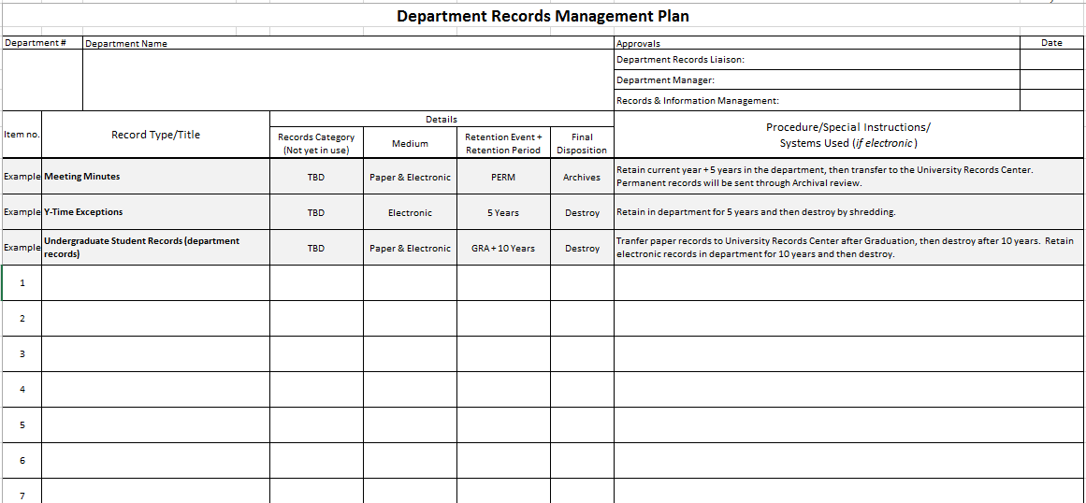
Department Records Management Plan

Slide 20
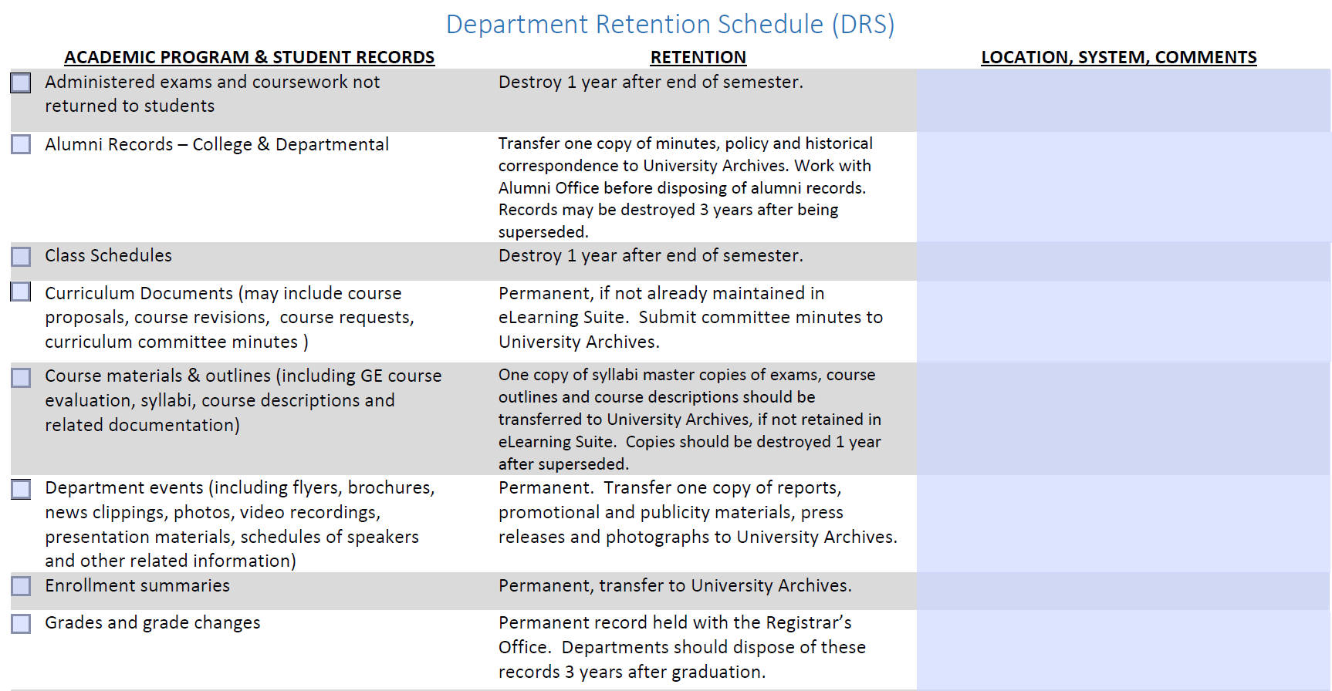

Slide 21
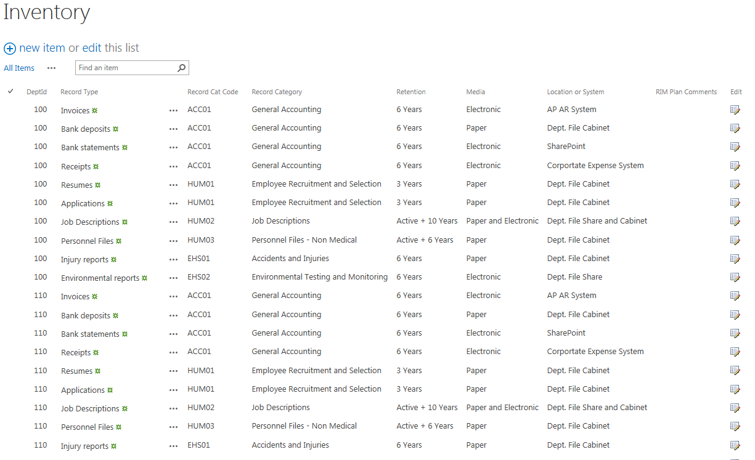

Slide 22
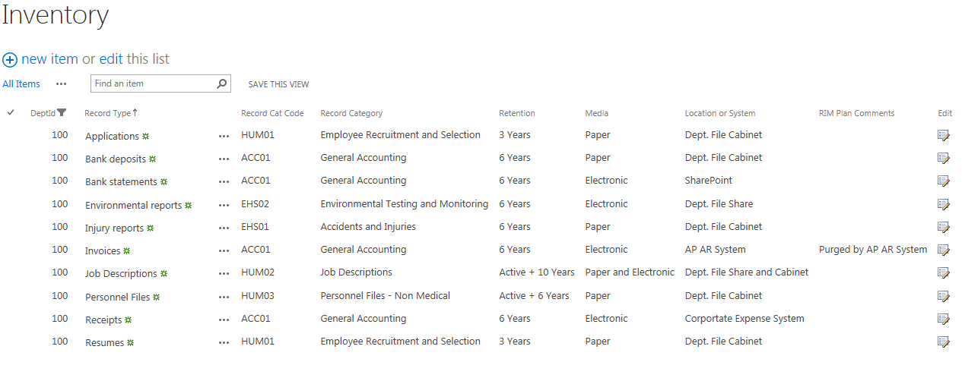
Filter by Department

Slide 23
Filter by Record Type

Slide 24
Thank You/Questions
Howard Loos, CRM, IGP
University Records and Information Manager
BYU
Howard_Loos@byu.edu
801-422-2161

